Slide 1
Computer Science
Complexity of Algorithms
Samuel Lukas

Slide 2
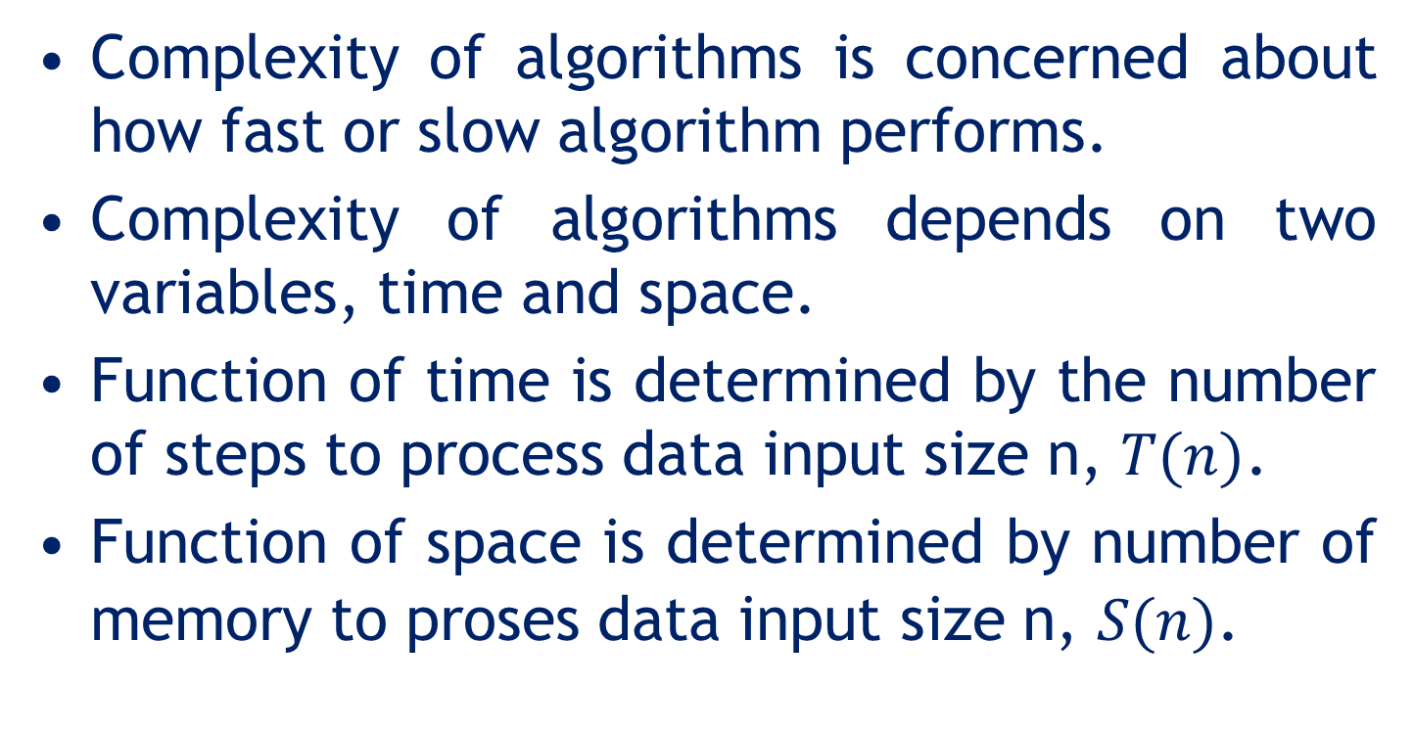
Introduction
Complexity of algorithms is concerned about how fast or slow algorithm performs.
Complexity of algorithms depends on two variables, time and space.
Function of time is determined by the number of steps to process data input size n, $T(n)$.
Function of space is determined by number of memory to proses data input size n, $S(n)$.

Slide 3
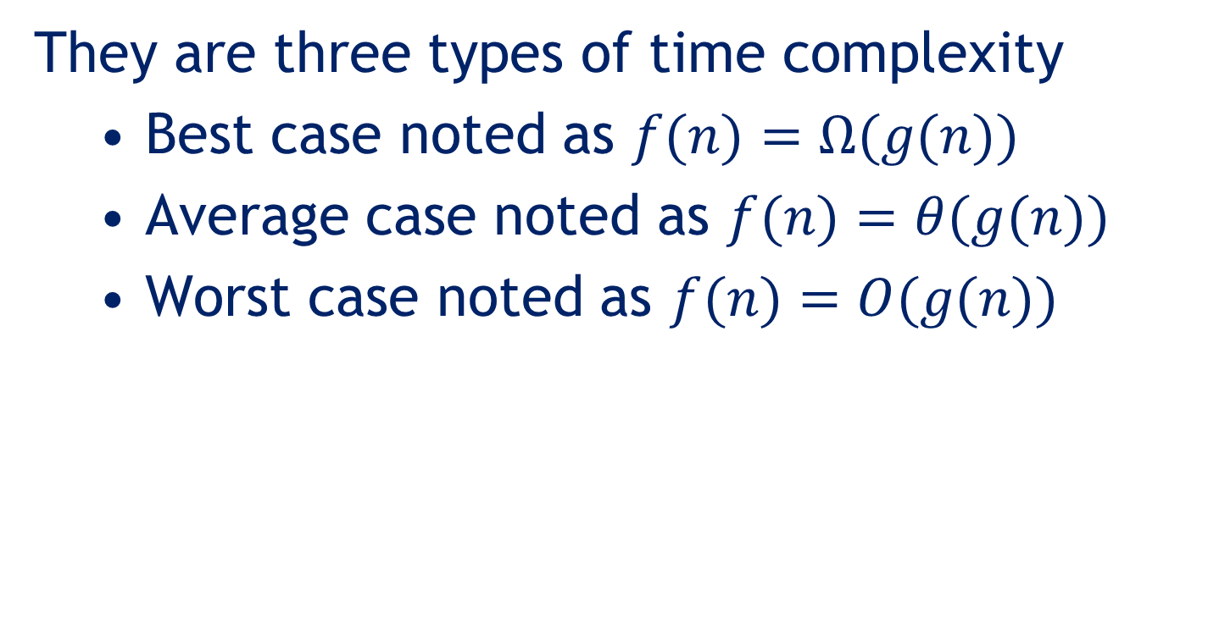
Time Complexity
They are three types of time complexity
Best case noted as $f(n)=Ω(g(n))$
Average case noted as $f(n)=θ(g(n))$
Worst case noted as $f(n)=O(g(n))$

Slide 4

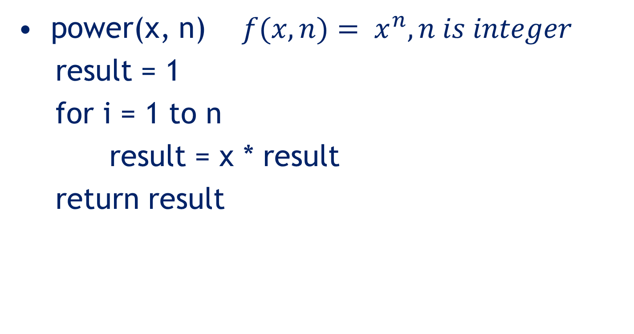

Example 01
power(x, n) $f(x,n)= x^{n}, n is integer$
result = 1
for i = 1 to n
result = x * result
return result
It needs $f(n)= 2n + 2$steps
$T(n)=O(n)$

Slide 5
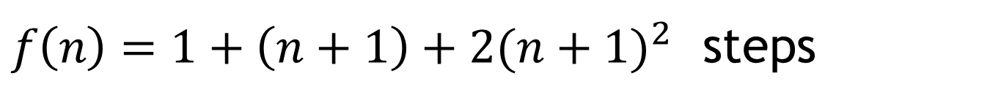
Example 02
Sum = 0
For i = 0 to n
for j = 0 to n
SUM = SUM + a[j]
$f\left(n\right)=1+\left(n+1\right)+{2(n+1)}^{2}$ steps
$$T\left(n\right)=O(n^{2})$$

Slide 6
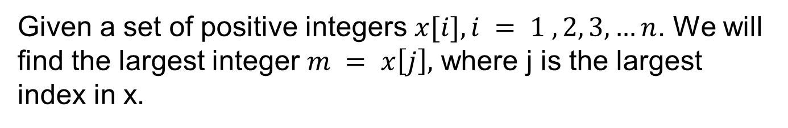
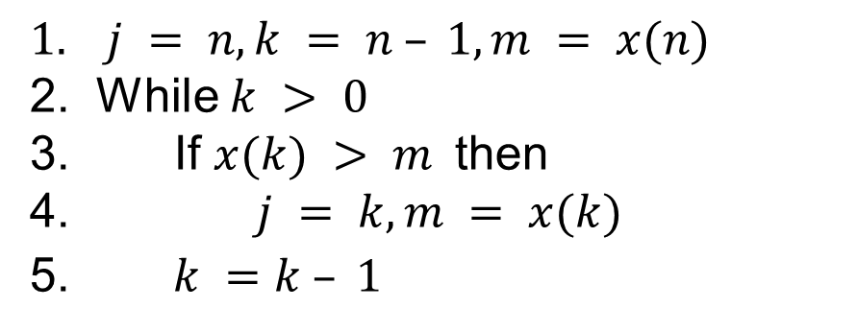
Example 03
Given a set of positive integers $x[i], i = 1 , 2, 3,…n$. We will find the largest integer $m = x\left[j\right],$ where j is the largest index in x.
$$1. j = n, k = n – 1, m = x(n)$$
2. While $k > 0$
3. If $x(k) > m$then
4. $j = k, m = x(k)$
5. $k =k – 1$
Step | 1 | 2 | 3 | 4 | 5
# execution | 1 | n | n - 1 | a | n -1
Minimum $a = 0$and maximum $a = n−1$

Slide 7
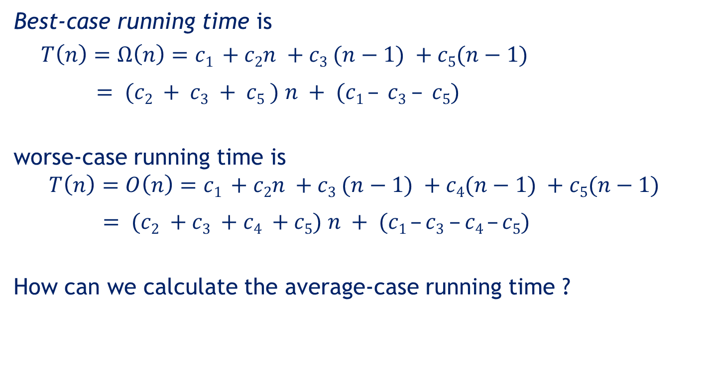
Example 03 (cont)
Best-case running time is
$T\left(n\right)=Ω\left(n\right)=c1 +c2n +c3 (n−1) +c5(n−1)$
$= (c2 + c3 + c5 ) n + (c1 – c3 – c5)$
worse-case running time is
$$T\left(n\right)=O\left(n\right)=c1 +c2n +c3 (n−1) +c4(n−1) +c5(n−1)$$
$= (c2 +c3 +c4 +c5) n + (c1 –c3 –c4 –c5)$
How can we calculate the average-case running time ?
The assumption is the appearance of data is equally likely

Slide 8



Example 03 (cont)
for n = 3 then the possibilities are
x[1] < x[2] < x[3] then a = 0
x[2] < x[1] < X[3] then a = 0
x[1] < x[3] < x[2] then a = 1
x[3] < x[1] < x[2] then a = 1
x[2] < x[3] < x[1] then a = 1
x[3] < x[2] < x[1] then a = 2
$$for n=3 then A=8/3$$
$$∴for n=n then A= ?$$
$$P_{n,x}:Probability A=x for n data set$$
$$P_{3,0} = 1/3 P_{3,1}= ½, P_{3,2}= 1/6$$
$$E(x) = 2∗1/3 + 3∗1/2+1∗1/6 = 8/3$$

Slide 9
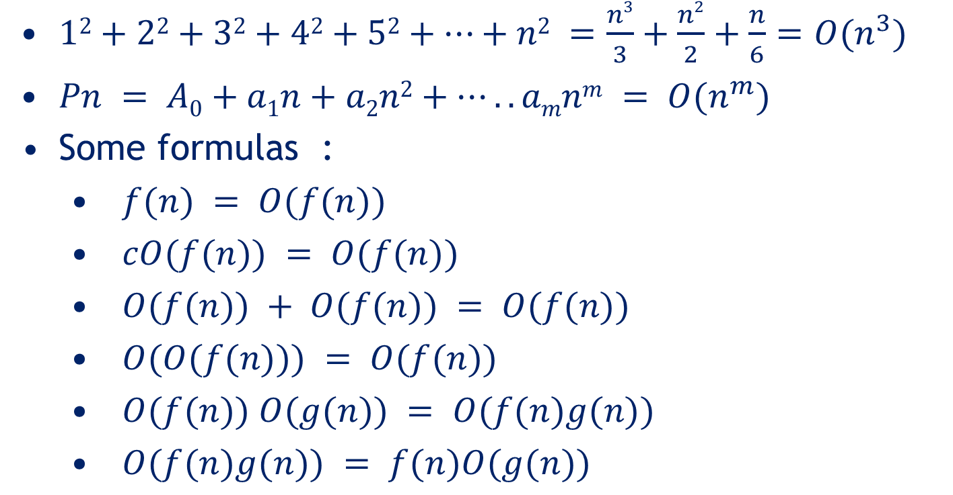
Big O notation
$12+22+32+42+52+…+n2 =\frac{n3}{3}+\frac{n2}{2}+\frac{n}{6}=O(n^{3})$
$Pn = A0+a1n+a2n2+…..amnm = O(n^{m})$
Some formulas :
$f(n) = O(f(n))$
$cO(f(n)) = O(f(n))$
$O(f(n)) + O(f(n)) = O(f(n))$
$O(O(f(n))) = O(f(n))$
$O(f(n)) O(g(n)) = O(f(n)g(n))$
$O(f(n)g(n)) = f(n)O(g(n))$

Slide 10
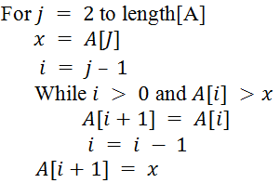




Big O of Insertion sort
$$……………………………………….n−1$$
$$………………………………………………….n−2$$
$$………………………………………………….n−2$$
$$…………………….(n−1)(n−2)$$
$$…………………….(n−2)(n−3)$$
$$…….…………………….(n−2)(n−3)$$
$$………...…………………………. (n−2)$$
$$f\left(n\right)=\left(n−1\right)+3\left(n−2\right)+\left(n−1\right)\left(n−2\right)+2(n−2)(n−3)$$
$$∴f(n)=O(n^{2})$$

Slide 11
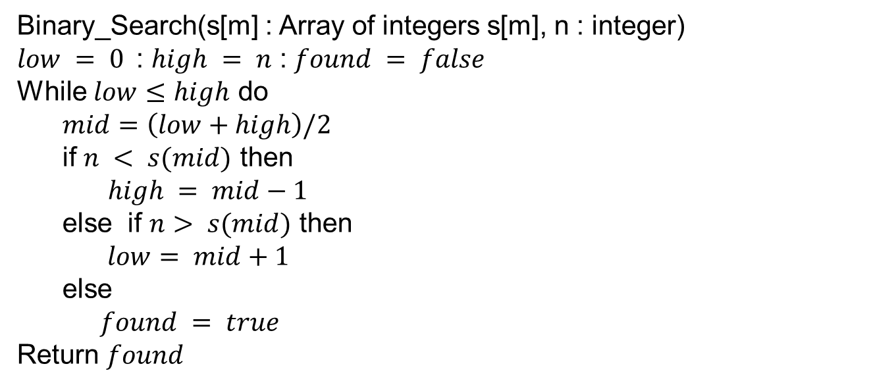

Big O of Binary Search Tree
Binary_Search(s[m] : Array of integers s[m], n : integer)
$low = 0$: $high = n$ : $found = false$
While $low≤high$ do
$mid=\left(low+high\right)/2$
if $n < s(mid)$ then
$high = mid−1$
else if $n> s(mid)$ then
$$low= mid+1$$
else
$found = true$
Return $found$
$$f\left(n\right)=1+{3log}_{2}{n}+a+{(log}_{2}{n})−a+b −b+1$$
$$∴f\left(n\right)=O(\log_{2}{n})$$

